Slide 1
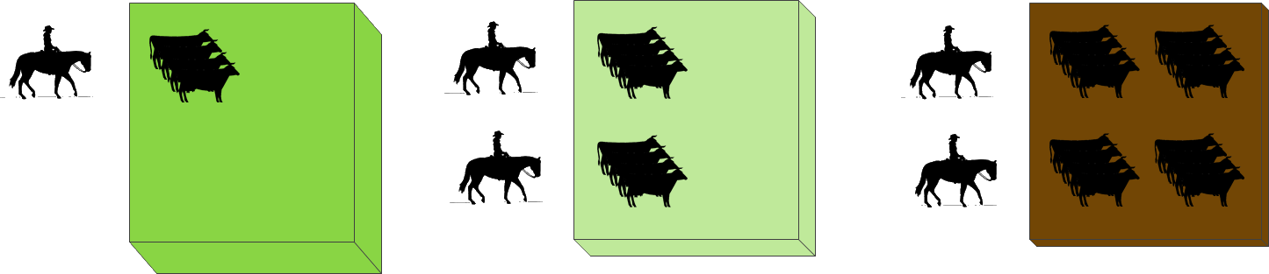
Tragedy of the commons
Hardin: Each man is locked into a system that compels him to increase…without limit. …Ruin is the destination…
Open access resource consumed by rational agents
Individual gain and shared cost
Leads to overexploitation and, inexorably, to depletion
G. Hardin “The Tragedy of the Commons“ (1968)

Slide 2
Tragedy of the commons
It belongs to the group of social dilemmas
No technical solution
Technical improvements postpone the problem
It can be applied to different domains:
Utilities: water, bandwidth
Food, energy
Pollution
Infrastructure: non-tolled highways/roads, bridges

Slide 3
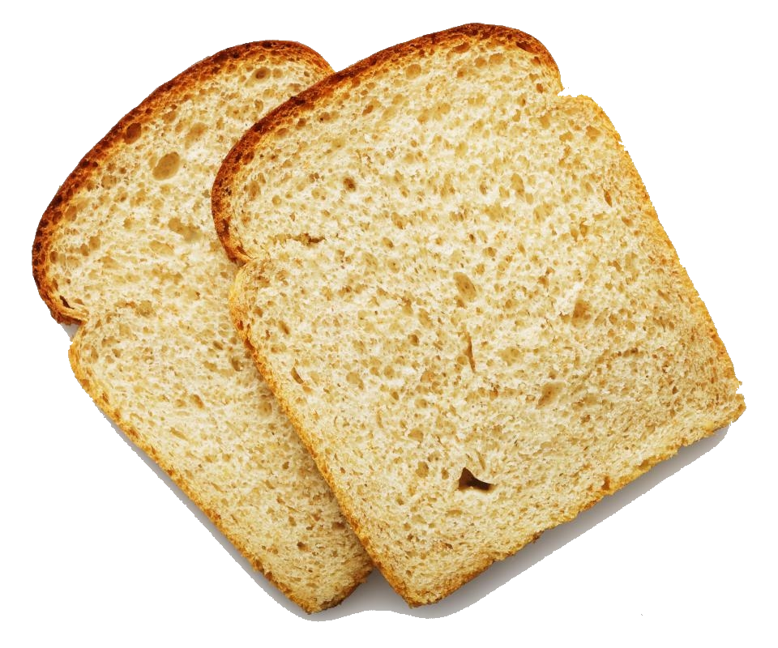
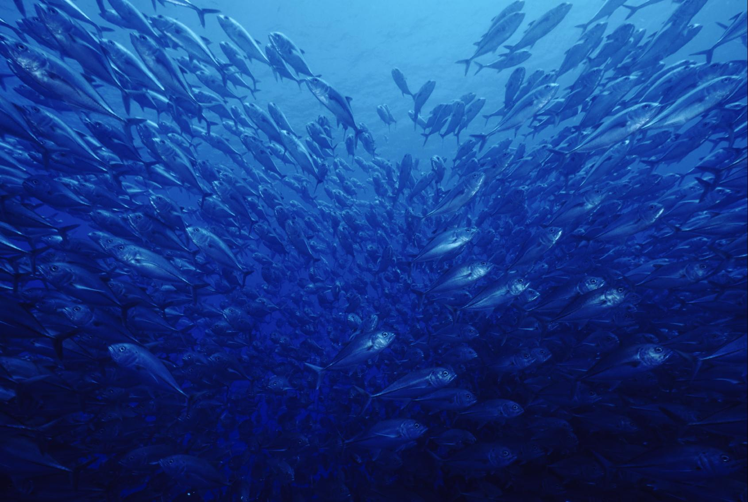

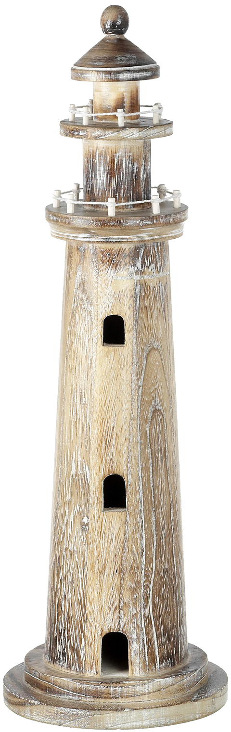
A taxonomy of goods
 | Exclusive | Non-exclusive
Rivalrous | Private good | Common good (Common-pool resources)
Non-rivalrous | Club good | Public good
Rivalry: One’s consumption diminishes other’s consumption
Excludability: Ability to prevent others from consuming
P. Samuelson “The Pure Theory of Public Expenditure“ (1954)

Slide 4
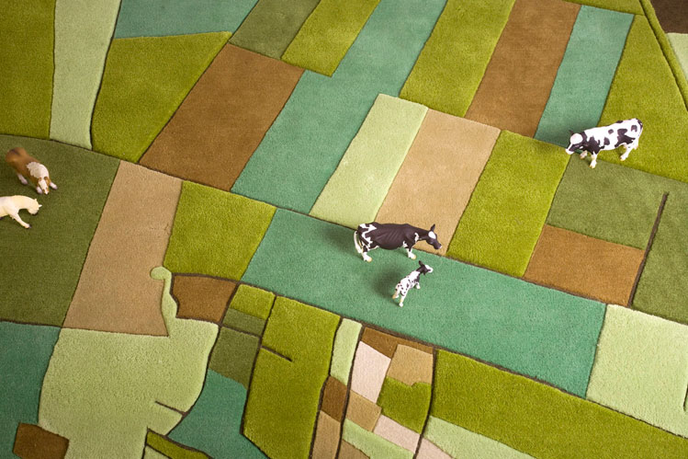
Collective action
Olson: Rational, self-interested individuals will not act to achieve their common… interest
Good provision in terms of group size and perceptibility of actions
Small
Medium
Privileged
Intermediate
Latent
Large
To ensure provision:
Coercive mechanisms
Exogenous benefit
M. Olson “The Logic of Collective Action: public goods and the theory of groups“ (1971)
Notes:
Example: irrigation system
Explicarlo con imágenes
Small: It is perceptible. If there is heterogeneity on land size, then somebody will be more benefited by
building an irrigation system.
Exploitation of the great by the small

Slide 5
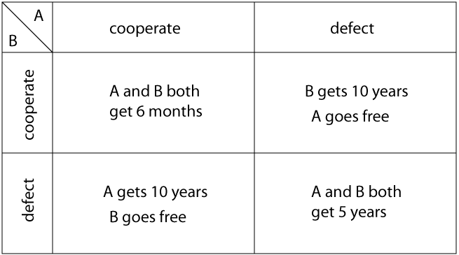

Social dilemmas
Prisoner’s dilemma:
Rational individual behaviour produces bad outcomes
Can be perfectly modelled in Game Theory
Can be modelled in Game Theory
Other approaches give better results
Free riding dilemma
Get the good
But do not pay for it
Tragedy of the Commons
Notes:
Hablar en términos de cooperator defector
Free-rider can be modelled with game theory with a certain satiability. Poner un ejemplo, un dibujo (ticket de metro)
Tragedy of the Commons, according to Ostrom, when modelled with Game theory has some drawbacks.

Slide 6
Tragedy of the Commons
A metaphor to explain the conflict between
A common good
A set of agents that seek to maximize their own benefit
Ends with the good exhausted because either
The agents expand their capacity to consume the good…
The agents’ population grows…
…beyond the good renewal capacity
Usually it is not being managed
G. Hardin “The Tragedy of the Unmanaged Commons“ (1994)

Slide 7
Tragedy of the Commons
A common good can be seen as a facility that:
Sustains a stock of resource units which produces a flow of resources units over time
Which divides the Tragedy into two problems
Appropriation: Allocating the flow of resource
Provision: Maintaining the stock of resource
E. Ostrom, R. Gardner, J. Walker “Rules, games and Common-Pool Resources“ (2006)
Notes:
Definir brevemente appropriation y provision. Añadir dibujo

Slide 8
Appropriation
The problem lies on the flow
Excluding potential beneficiaries
Allocating the subtractable flow

Slide 9
Provision
The problem lies on the stock
Creating, maintaining a resource
Improving production capabilities
Avoiding the destruction of the resource
Notes:
Depending on what was done in previous steps, the stock may vary which directly affects the flow.

Slide 10
River basin
Rivers are massively exploited as
Means of transport
Fishery
Part of industrial processes:
To consume water
To discharge wastewater

